Slide 1


How do entrepreneurs learn
& share learning?
Entrepreneurial Learning in Organisations Special Interest Group
Manchester Metropolitan University
25 June 2012
Professor David Rae
ISBE Vice-president, education
drae@lincoln.ac.uk

Slide 2


Professor David Rae
Career in small business, government & higher education
Entrepreneurship researcher, educator & writer
Entrepreneurial learning: PhD & publications 1999-2012
Director of Enterprise & Innovation, Lincoln Business School,
University of Lincoln
Vice-president, Institute of Small Business & Entrepreneurship
New editor, IJEBR
Optimist, based on human creativity & potential for learning
drae@lincoln.ac.uk
‘Warycat’ on Twitter

Slide 3
Session topics….
What is entrepreneurial learning?
Why does it matter?
Entrepreneurial learning in organisations
New perspectives on how entrepreneurs learn & share learning
Questions for the ELSIG…
Entrepreneurial Learning

Slide 4
1. What is entrepreneurial learning?
2. What does it mean to you?
3. Why does it matter to us today?
Entrepreneurial Learning

Slide 5
What is entrepreneurial learning?
Entrepreneurial Learning

Slide 6
What is Entrepreneurial Learning?
Learning and acting in innovative, opportunistic ways
Applying creativity: from idea to activity
Recognising, creating and acting on opportunities
Creating & applying new knowledge & practices
Social interactions for personal & shared learning
Imaginative use of technologies
Creating multiple forms of value
Initiating and managing organisations
Transformative, social, imaginal, emotional & experiential
Applies in a range of contexts….
Entrepreneurial Learning
Notes:
6
6

Slide 7

Why does it matter?
If only there was a better way…
Acknowledgements to the work of
E.H Shepard
The icons of ‘Pooh’, ‘Piglet’,
‘Eeyore’, ‘Wol’ and
‘Christopher Robin’ may
(or may not)
represent entrepreneurial
identities at a subliminal level…

Slide 8
Why does entrepreneurial learning matter?
Economic:
Regeneration & growth, innovation, job & wealth creation
Find and enact opportunities which create value from latent resources
Educational:
Enhance human capability & potential in the new era
Enable excluded & disadvantaged groups to participate in learning & society more effectively
Develop peoples’ confidence to act in uncertainty
Research:
Create & use new knowledge in a rapidly changing world
Entrepreneurial Learning

Slide 9
A model of entrepreneurial learning
A conceptual model of entrepreneurial learning based on narratives & social constructionism:
  Personal and social emergence - entrepreneurial identity
  Contextual learning
  - opportunity & practice through social participation
  Negotiated enterprise
  - creating the venture in
  concert with others
Rae, 2003
Entrepreneurial Learning

Slide 10
Triadic model of entrepreneurial learning: with sub-themes
Entrepreneurial Learning
Rae, 2003

Slide 11
Triadic model of entrepreneurial learning: with sub-themes
Rae, 2003
Entrepreneurial learning in organisations

Slide 12
Applying Entrepreneurial Learning in education
Entrepreneurial Learning

Slide 13
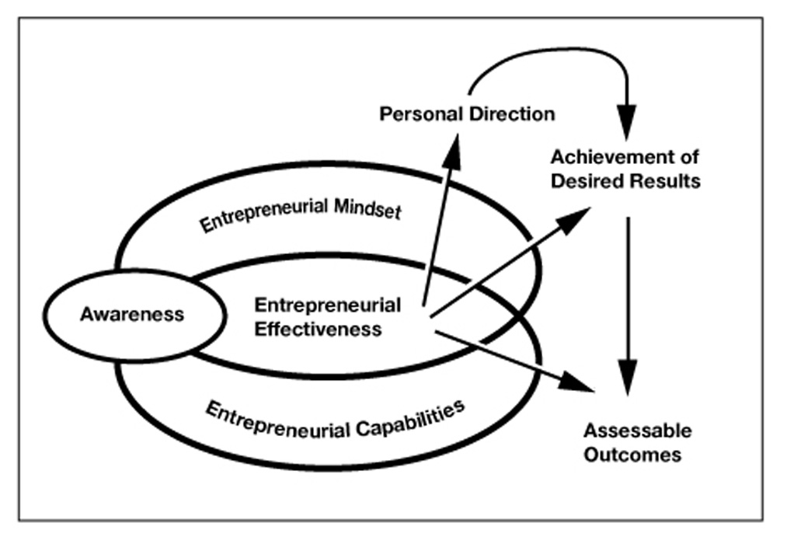
Entrepreneurial learning: awareness, mindset & capabilities (Rae 2012)
Key idea in the QAA document
‘Enterprise and entrepreneurship education: Guidance for UK higher education providers’
http://www.qaa.ac.uk/Publications/InformationAndGuidance/Documents/EE_Draft_Guidance.pdf

Slide 14
Opportunity-centred entrepreneurship
A methodology for entrepreneurial learning through exploring and working on opportunities.
It includes four clusters of activities:
Personal enterprise - connecting opportunities with goals and identity
Creating & exploring opportunities
Planning to realise opportunities
Acting on opportunities
www.palgrave.com/business/rae/

Slide 15
Opportunity-centred entrepreneurship: methodology
What do I want?
Personal goals
Skills & strengths
Confidence & self efficacy
Values & motivations
Networking
Creating & using contacts
Communicating effectively
Self marketing
Learning from experience
Reflection
Active & social
engagement
Prospective
imagination
Generative
curiosity
Planning:
Goals & activities
Aiming for success
How-to?
Who with?
Resources
Creative thinking
Exploring ideas
Seeing needs as
opportunities
Taking initiative
Notes:
15

Slide 16
Winning ideas > opportunities
3. Innovations
& solutions
2. Who is it for?
1. Turn problems
& needs
> opportunities
4. How to make
it happen

Slide 17

Entrepreneurial learning in practice: the case of Business Inspiration
Small business leadership recovery programme for owners & managers of 60 firms
How did people learn?
What did they learn?
Comparison with ‘LEAD’ & Goldman Sachs 10k programs?
From ISBE conference paper 2011
To be published in ‘Industry & Higher Education’ Dec 2012
Entrepreneurial Learning

Slide 18
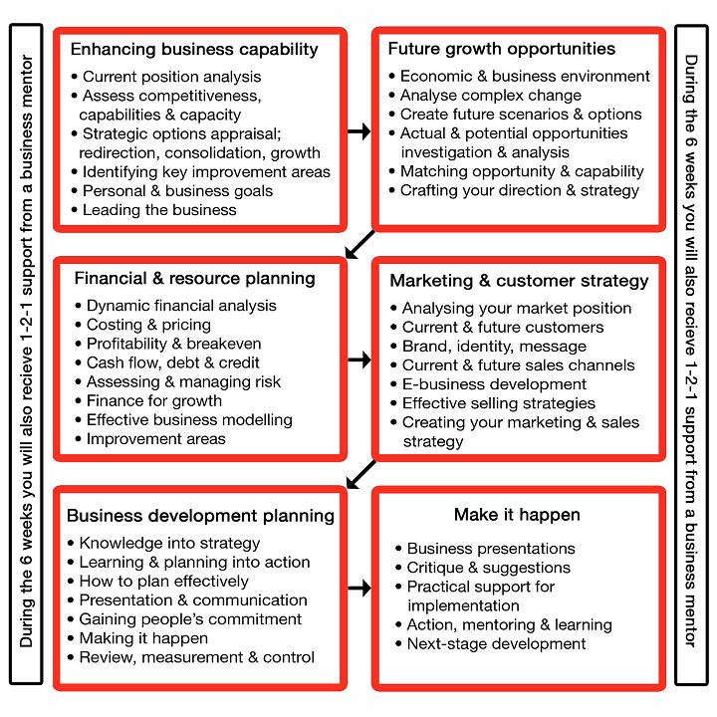
Programme Structure

Slide 19
How did people learn?
Entrepreneurial Learning
Social: group, informal networking, mutual help
Peer-peer: relational learning, trust & empathy
Facilitated: mentors & coaches
Teaching: they all learned & liked different things
Practice: in-company projects &opportunities
Active implementation: problem-solving
Critical moments
Time out of the business for reflection & planning

Slide 20
Entrepreneurial-organisational learning arena
Expert-firm learning:
Professional advisers
Law, accounting, IT
HE & FE programs
Consultants
Inter-firm learning:
Business networks
Personal contacts
Supply chains
Collaborative projects
In-firm learning:
Entrepreneur
Management team
Employees
Customers, suppliers
Learning media:
Face-face
Opportunities & problems
Programs
Projects
Social media
Interactive e-learning
Entrepreneurial Learning

Slide 21
Momentary perspective on entrepreneurial learning: the power of the moment
Entrepreneurial Learning

Slide 22
Why moments matter for entrepreneurs, researchers & educators
The ‘aha’ or ‘Eureka’ discovery moment
Recognising opportunities
‘Moments of truth’ in interactions with people
Serendipity – ‘chance’ encounters, meetings & discoveries
Split-second decision-making
Using intuition, instinct & gut-feel
Emotional awareness & subconscious processes
Value creation & capture in the moment (buying online)
Digital eye-brain interactions:
    Twitter messages
    Website visits
    Email & messaging
Realising you’ve just got it wrong….
Entrepreneurial Learning

Slide 23
Living in the moment
‘Now’ is an important time
Moment: ‘a point in time, an instant’; ‘a turning point in a series of events’.
We live in the moment: authentic experience & self-actualisation situated in consciousness between past experience and future anticipation
Creative entrepreneurs make sense and act in the moment, connecting subjective experience with wider context
Momentary perspective offers new understanding of entrepreneurial learning & behaviour: creativity, transformation, action.
Entrepreneurial Learning

Slide 24
Learning in the moment
Entrepreneurial Learning

Slide 25
Generating meaning
in ‘the moment’
Meaning
Perceiving
Acting
Being
in the moment
Experiential memory
Prospective imagination
Past recollections
Future anticipations
Narrative time
What is likely to happen?
What future possibilities &
opportunities are there?
What action can I take?
How do past
experiences help make
sense of the moment?
Kairotic time: events
Chronos time: linear
Entrepreneurial Learning

Slide 26
Examples & types of entrepreneurial moments
Creativity – inspirational moment of association forming a new idea
Innovation– recognising how an idea can be applied to a practical situation
Opportunity – recognising a potential or actual position of advantage
Problem – a disadvantage or setback to be addressed
Encounter – social interaction, meeting or social connection
Insight – gaining a realisation of new knowledge
Intuition – ‘knowing’ at a subconscious or ‘gut’ level
Judgement – making a decision or choice
Resolution – intention to act
Entrepreneurial Learning

Slide 27
Entrepreneurial Learning meets Cloud…
This concept was developed as a
European partnership for a
DG Enterprise bid to share
entrepreneurial learning
resources.
Bid not submitted but the partnership
continues to develop the concept
– members & contributors
welcome.
Entrepreneurial Learning

Slide 28
Entrepreneurial learning special interest group: questions for discussion
What new knowledge in entrepreneurial learning and organisations is being produced?
How can this be shared – between researchers, entrepreneurs, educators, advisors?
How can this be applied – in business practice & support, education, policy, research?
What perspectives can be shared with other fields?
e.g. social, public & health sectors?
How can we gain ‘official’ endorsement of this?
What will make this group sustainable?
Entrepreneurial Learning

Slide 29



Creating Opportunities through Innovation: Local Energy, Global Vision
DUBLIN, Ireland. 7th-8th November 2012
www.isbe.org.uk/ISBE2012

Slide 30

Thank you!
drae@lincoln.ac.uk

